Slide 1
Global Transaction Services
Client Advisory Board for
Investment Managers in Asia Pacific
Hong Kong 23 March 2012

Slide 2
Featured Speaker
Christina Choi
Director
Investment Products Department
Hong Kong Securities and Futures Commission

Slide 3
Welcome to 2012 Client Advisory Board
Follow-Ups from 2011 Meeting
David Russell
Regional Head, Asia Pacific
Securities and Fund Services
Global Transaction Services, Citi

Slide 4
Citi in Asia
Asia Pacific
19 Countries
28% Citicorp’s Net Income
100+ Years in Asia
400+ Awards in 2011
50,000+ Employees
Citigroup's Asia Net Income $4.0 Billion
GTS + S&B
18
Countries
54,000+
Institutional Clients
160,000,000,000
Money Raised for Asia Clients
1,400,000,000,000
Assets Under Custody
RCB
14
Countries
722+
Retail Branches
648,000
Citigold Private Client and Citigold
31,000,000
Retail Banking Customer Accounts
165,000,000,000
Assets Under Management
Global Transaction Services (GTS) 29.3%
Regional Consumer Banking (RCB) 48.2%
Securities and Banking (S&B) 22.5%
1

Slide 5
GTS – Organized by Client, Product
Securities and Fund Services (SFS)
Treasury and Trade Solutions (TTS)
Fund Services
Investment Administration Services (Middle Office)
Global Custody
Securities Finance
Cash Management Trade
Receivables
Liquidity and Investments
Payments
Commercial and Prepaid Cards
Information Services
Trade Services
Trade / Supply Chain Finance
Export and Agency Finance
Issuers Intermediaries Investors
Corporates, Public Sector, FIs
Clearing and Settlement
Direct Custody
Agency and Trust
Depositary Receipts
2

Slide 6
Citi GTS Asia – Client Advisory Board
Purpose and Objectives:
“A forum to obtain advice on how to improve our services, validate what we do well, share industry insights, network and build relationships, to help build a partnership to grow and optimize our respective businesses.”
3
Notes:
6
6
6

Slide 7
Follow-Ups from 2011 Meeting
Help Facilitate more Dialogue with Regulators
Distribution of Related “Pain-Points”
RMB Services
Focus on Smaller Global Managers Looking to Enter Asia
4

Slide 8
Open Dialogue:
Citi Distribution Roundtable
Paul Hodes
Head of Traditional Managed Investments Products and
Consumer Bank Wealth Management
Asia Pacific, Citibank, N.A.
Roger Bacon
Head of Managed Investments and Advisory
Asia Pacific, Citi Private Bank
Stewart Aldcroft
Senior Advisor, Investor Services, Asia Pacific
Securities and Fund Services
Global Transaction Services, Citi
(Moderator)

Slide 9
Global Transaction Services
Client Advisory Board for
Investment Managers in Asia Pacific
Hong Kong 23 March 2012

Slide 10
China Insight
Andrew Au
Chief Executive Officer, Citi China
Cheeping Yap
Head of Fund Services, Asia
Securities and Fund Services
Global Transaction Services, Citi
(Moderator)

Slide 11
China Insight
Andrew Au
Chief Executive Officer, Citi China

Slide 12
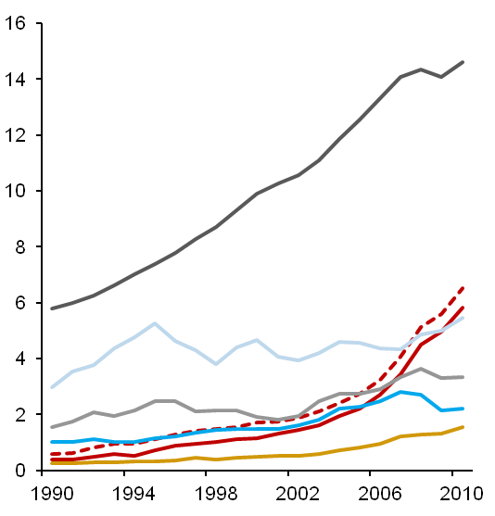
China – Growth Engine of the World
China has been growing at 14.5% annually over the last 20 years; it represents around 42% of Asia’s banking revenue pool today and will contribute 55% of incremental revenue between 2010 and 2015.
China Already the 2nd Largest Economy in the world
($ in Trillion)
Largest Banking Revenue Pool in Asia
($ in Billion)
’10–’15 CAGR
CAGR
10%
U.S.
4.7%
1,512
8
17%
323
4%
20%
12.4%
910
11%
Greater China
Other Asia (Emerging)
4
China
14.5%
6%
Japan
2.9%
Other Asia (Developed)
259
Germany
3.9%
India
712
13%
UK
4.0%
Southeast Asia
India
8.1%
Korea
13%
China
382
Greater China
Greater China combined GDP surpassed $6 Trillion in 2010 and will grow to $14 Trillion by 2015
On a PPP basis, Greater China will overtake the US as the world’s largest economy by 2017
China
(% of Total)
42%
47%
1
Source: IMF Database, CIR forecasts.
* PPP – Purchasing Power Parity using 2010 prices.
Source: McKinsey Market Sizing (2011), Asia Capital Markets Monitor, EIU Country Finance Report (2009)

Slide 13







Highly Regulated Banking Industry
Citi China operates in a complex regulatory environment. Given Citi’s long-term strategic interests in China, we need to take a long-range view and work with regulators at all levels to promote market opening/regulatory approval.
Highly Regulated Banking Industry
Gradual Market Liberalization
Complex regulatory environment
Multi-agency and multi-layer regulatory apparatus
Significant manual control, documentation checking and reporting requirements for transaction processing
Regulatory requirements for onshore data center and restrictions on cross-border PII ⁽¹⁾ data transfer
Interest rate restrictions with limited pricing flexibility
Capped deposit rates and floored lending rates
Expansion of foreign banks remains curtailed
Branch licenses subject to discretionary approval
Prerequisite approvals for all new products
Limited capital markets capabilities compared to local banks
No timetable for removal of foreign investment cap
Regulators largely honored WTO commitments
Over 100 foreign banks in China, of which 37 have locally incorporated since 2007
Retail RMB licenses have been granted to eligible foreign banks, opening up a full range of products
Market liberalization in a controlled manner
Uneven pace of market liberalization, driven by policy considerations and market conditions
Regulators remain cautious about complex financial products (e.g., capital markets)
Gradually lifting restrictions for foreign banks, recent positive developments include:
Foreign banks to participate in STN/MTN trading
Foreign banks to distribute domestic mutual fund
Promotion of cross-border RMB settlement
2
(1) PII: Personal Identifiable Information

Slide 14
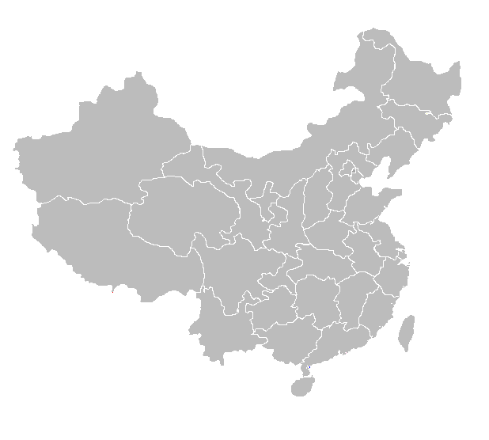



Citi China History and Current Presence
1902
1941
1945–1951
1983
2002
2006
2007
Opened Shanghai Branch, First American bank office in China
Closed Shanghai Branch, the last one to be closed due to war
Reopened after the War and final liquidation
Back to China, opened Rep Office in Shenzhen
Entered into strategic alliance with SPDB
Made equity investment (20%) in GDB
Subsidiarization: among first 4 foreign banks to subsidiarize, with RMB license to offer a wide range of services to Chinese residents
2012 YTD
13 operating branches
47 consumer outlets
4 lending companies
2 Citigroup Global Markets rep offices (Shanghai, Beijing)
Citibank N.A. Retained Branch, 1 representative office
Software and Operation Centers in Shanghai, Guangzhou, Zhuhai, Dalian
Citigroup Management Consulting Company
Equity investment in GDB and SPDB
All Citi entities in China employ over 6,000 employees
Beijing
Dalian
Tianjin
Nanjing
Chengdu
Wuxi
Shanghai
Chongqing
Hangzhou
Changsha
Existing branch
Guiyang
Branch to open
Guangzhou
Representative office
Lending company
Shenzhen
COE
3

Slide 15
Distribution Network
The 13 cities in Citi China’s current network covers 25% of GDP and 160 million population.
Expected to grow the branch distribution network to over 20 cities.
Citibank Branches
Summary of Citi Presence
Citibank Branches
GDP per Capita ($, 2010)
Potential Branches
First Tier. $5,000+
Rep Office
Second Tier. $3,000–5,000
City | GDP ($ billions) 2010 | GDP (%) 2010 | POP (MM)
Shanghai | 249 | 4.2% | 23
Beijing | 204 | 3.5% | 20
Guangzhou | 157 | 2.7% | 13
Shenzhen | 140 | 2.4% | 10
Tianjin | 135 | 2.3% | 13
Chongqing | 116 | 2.0% | 29
Hangzhou | 87 | 1.5% | 8
Chengdu | 81 | 1.4% | 13
Wuxi | 85 | 1.4% | 6
Dalian | 76 | 1.3% | 6
Changsha | 67 | 1.1% | 7
Nanjing | 61 | 1.1% | 8
Guiyang | 12 | 0.2% | 4
Total | 1,470 | 25% | 160
Total (China) | 5,879 | 100% | 1,393
Third Tier. $1,000–3,000
No. of Citi Branch
11
9
3
5
4
3
4
2
1
1
1
1
1
47
47
Fourth Tier. Less Than $2,000
Ha’erbin
Changchun
Shenyang
Dalian
Beijing
Tianjin
Qingdo
Zhengzhou
Jinan
Xi’an
Nanjing
Wuxi
Shanghai
Heifei
Hangzhou
Chengdu
Chongqing
Wuhan
Ningbo
Nanchang
Fuzhou
Guiyang
Changsha
Xiamen
Guanzhou
Kunming
Dongguan
Shenzhen
Source: National/Municipal Bureau of Statistics, Census.
4

Slide 16
Q&A

Slide 17
Advisory Council:
Citi’s Securities and Fund Services Business Priorities
David Russell
Regional Head, Asia Pacific
Securities and Fund Services
Global Transaction Services, Citi

Slide 18
Evolution – Growth with Diversification
Business Growth
Bisys Acquisition
Client Segment Penetration
(Indexed to 1Q’96 at 100%)
(Aug 07)
2005
2011
Aegon & DFA Lift-out
Acquisition / Lift-out
(2006)
Mutual Funds
Organic
Unisen Acquisition
$2.9B
Institutional Asset Managers
(Oct 05)
Investor
ABN Amro Acquisition
$0.7B
Alternatives
Forum Acquisition
(Oct 05)
(Dec 03)
SWFs / Local Pensions
SLI Lift-out
Inter.
Brokers, PBs, and Custodians
(Nov 03)
Infrastructures (MTFs / ECNs)
$2.2B
Iss.
FIs / Corporates / Governments
WM
Private Banks / Family Offices
(1) Excludes US pensions
Local Custodian Network
Top 10 Global Custodians
2010 USD $ billion
Custodian | AUC | Market Share | Cross- Border AUC | Cross-Border Rank | Cross-Border/ Total AUC
BNY Mellon | 21,800 | 23% | 8,300 | 1 | 38%
J.P. Morgan | 14,900 | 16% | 6,500 | 3 | 44%
State Street | 14,000 | 15% | 3,000 | 5 | 21%
Citi | 11,300 | 12% | 7,700 | 2 | 68%
BNP Paribas | 5,793 | 6% | 3,186 | 4 | 55%
HSBC | 4,384 | 5% | 2,465 | 6 | 56%
Northern Trust | 3,551 | 4% | 1,869 | 7 | 53%
RBC Dexia | 2,427 | 3% | 1,379 | 9 | 57%
BBH | 2,297 | 2% | 1,638 | 8 | 71%
1
4

Slide 19
Wallet Size – Services in Asia Pacific
Citi
Citi SFS Value Capture Point (Current)
2

Slide 20
Investor Services Capabilities
Capabilities
ETF
Institutional
Mutual Funds
Hedge / FoF
Private Equity
Pension
Research
Front Office
Portfolio Management
ETF
(End-to-End)
OpenPrime
Pension Vertical Specialist Services
Trading
Execution to Custody / CIS / CitiConnect
Order Management
Institutional Portfolio Services
(Middle Office)
Hedge Fund Portfolio Services
(Middle Office)
Pricing
Portfolio Accounting
Private Equity Administration
Middle Office
Performance / Risk
Data Management
Investor Reporting
OTC Derivatives
Collateral Management
Collateral Management
Fund Services
HF Services
Private Equity Administration
Fund Administration
Collateral Management
Back Office
Transfer Agency
Custody / FX
Global Custody
FoF / Custody
Securities Lending
Securities Lending
Note: Un-shaded portion indicates services generally in-house, not outsourced or done by alternates
Under Development
3
Notes:
20
We provide services across client segments ranging from asset managers to hedge funds, corporations, private equity, public sector, wealth bank and insurance, and across the value chain – whether it is front office, middle office, back office. Our solutions sets and capabilities address your needs

Slide 21
Investor Strategy Asia
Build out Local Funds Servicing & Transfer Agency
End-to-end ETF Services
Pension “Vertical” Specialist Services
Expand Middle Office and Outsourcing
Rollout Collateral Management
4

Slide 22
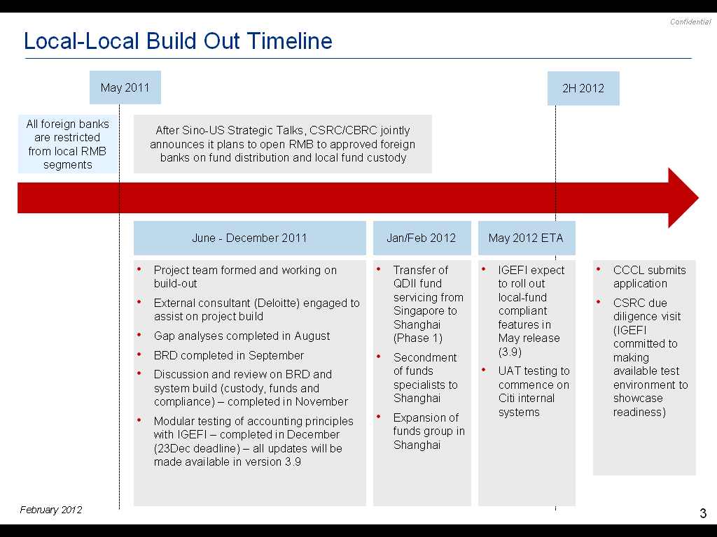
Build out Local Funds Servicing & TA
China Local-Local Custody Buildout
Korea Funds
Australia Super Fund Build
Transfer Agency
5

Slide 23
End-to-End ETF Services
Integration of ETF GEM system
6

Slide 24
Pension “Vertical” Specialist Services
Pension Funds
Investment Managers
Pension Fund Reporting
Performance Measurement
Middle Office
Other Factors
Capacity
Depth of Expertise
Track Record
Core Requirements
Fund Accounting
Domestic and Global Custody & Sec Landing
Competitive and Market Factors
On-the-Ground Service
Concentration Risk
Education and Advisory Support
Markets Offering
Transition Management
Prime Brokerage / Futures
Execution
SFS Offering
PE/LP Investor Service
Hedge Fund Service
Yield Book / CDS
Cash Management
Liquidity Solutions
Payments
Cards
Value Adds
7

Slide 25
Expand Middle Office and Outsourcing
7

Slide 26
Rollout Collateral Management
(Citi OpenCollateral)
8

Slide 27
Global Transaction Services
Client Advisory Board for
Investment Managers in Asia Pacific
Hong Kong 23 March 2012

Slide 28
声明：
所有的版权属于原有公司，文件均来自公开渠道
此文件仅供学习使用，任何人不得进行以此为商业目的的行为
如有疑问，请立即删除
学习世界五百强和咨询公司PPT课程请访问如下网站搜索：“司马懿”
百度传课：司马懿PPT学校
https://www.chuanke.com
网易学堂：司马懿PPT学校
https://study.163.com
知乎： 司马懿PPT学校
https://www.zhiu.com

